Slide 1
Ocean Acidification

Slide 2
Quick Activity:
What is your favorite animal?
Notes:
Tell them to pay attention to each other’s answers!

Slide 3
In your kitchen...
What are 3 acidic things?
What are 3 non-acidic things?

Slide 4
Why does
acidity
matter?

Slide 5
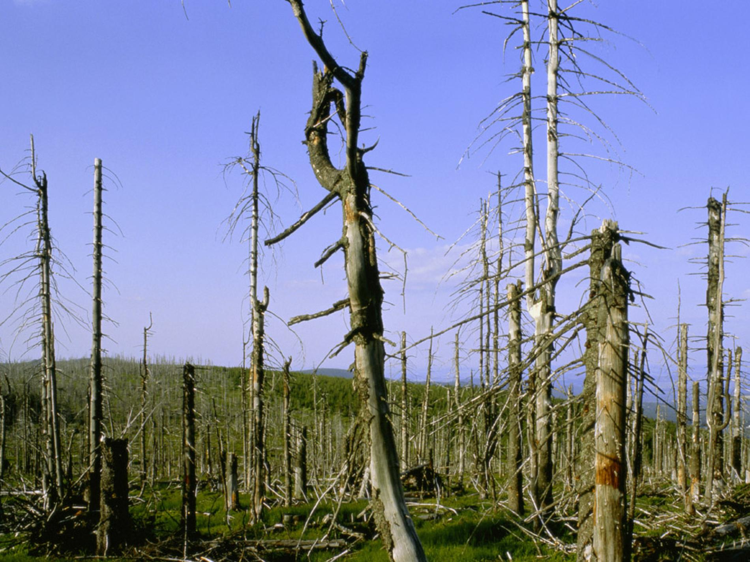
Acidity in the atmosphere can cause acid rain, damaging forests.
Notes:
Chemicals like sulfur dioxide (SO2), nitrogen oxides (NO2, NO) are released when burning fossil fuels, react with water, oxygen, CO2, and sunlight in the atmosphere to form sulfuric and nitric acids.

Slide 6
What will happen if acidity in the ocean increases?
Notes:
Chemicals like sulfur dioxide (SO2), nitrogen oxides (NO2, NO) are released when burning fossil fuels, react with water, oxygen, CO2, and sunlight in the atmosphere to form sulfuric and nitric acids.

Slide 7
Today’s Questions...
What is acidity?
How do we measure it?
What is ocean acidification?
What is its effect on wildlife?
What can we do against it?

Slide 8
Lab Safety

Slide 9

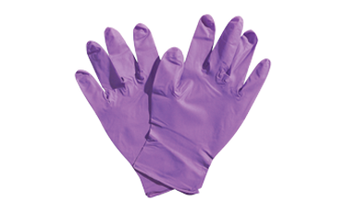
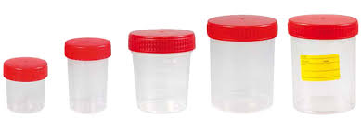
Lab Safety
Wear gloves
Different solutions, different containers
Identify and Label immediately
Notes:
You can also talk about:
Safety goggles
Closed toe shoes
We are doing a “kitchen experiment”, so these are not required (although they would make it safer!). In a lab, we would probably need them!

Slide 10
Remember this?
What is your favorite animal?
Notes:
Ask if anyone remembers what everyone said for their favorite animal
This activity shows that it’s easy to forget things, even if only a few minutes have passed.

Slide 11
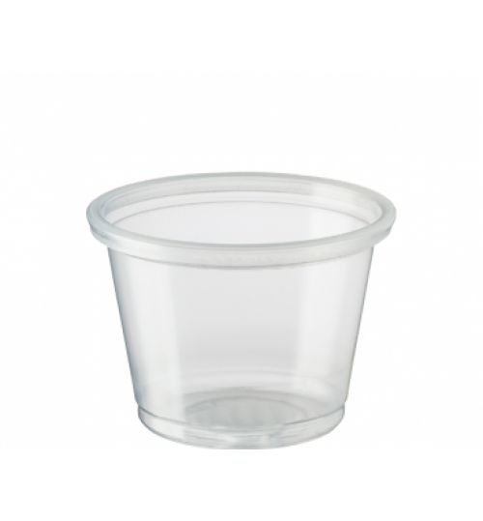
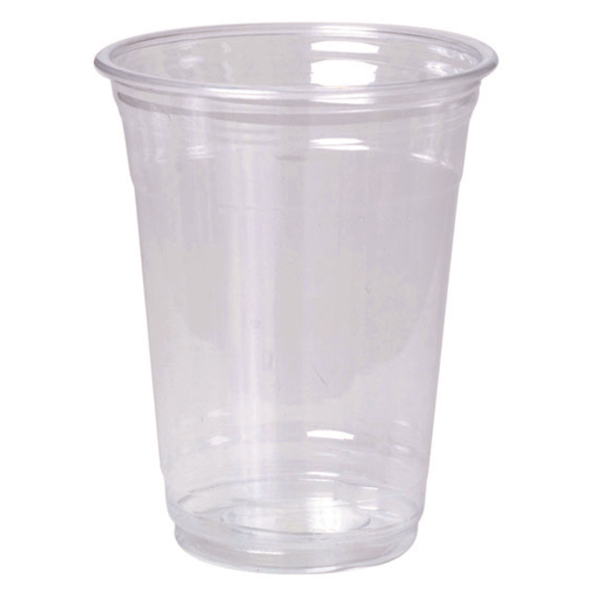

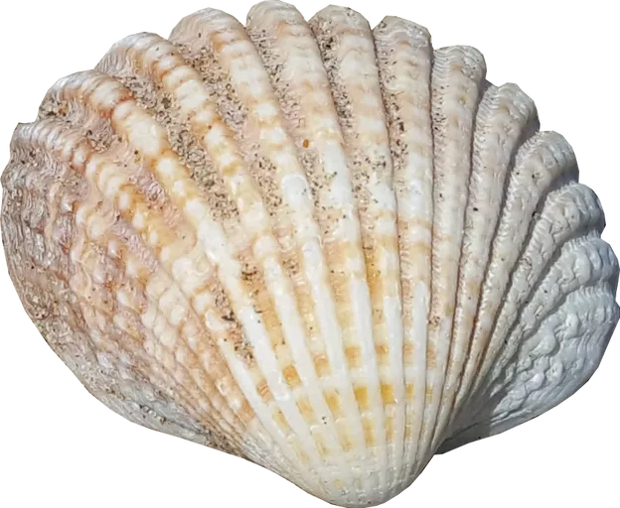
Shell experiment set-up
steps 1-7
5 grams
5 grams
5 grams
Notes:
Ask why we have a cup with plain water? Scientific Method - need a control solution.
(optional): move the cups to a counter after setup

Slide 12
pH measurement
step 1
ranking solutions

Slide 13
pH scale
0-7 acidic
7 neutral
7-14 basic
Notes:
Also show the pH paper as a way to measure pH. Can also bring up pH meters.

Slide 14
pH measurement
steps 2-4
testing solutions

Slide 15
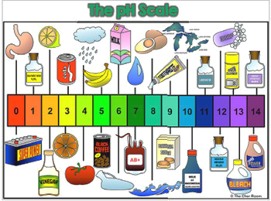
0-7 acidic 7 neutral 7-14 basic
Notes:
Talk about foods - most foods are acidic, which is why eating too much can lead to an upset stomach
How to combat upset stomach? -> antacid which is a base
Are any of the solutions bad for you? -> 0-2 (too acidic) and 12-14 (too basic) can be bad

Slide 16
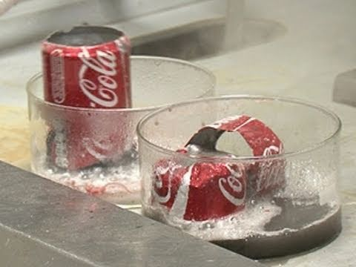
STRONG ACIDS
&
STRONG BASES
Notes:
Video on Extremes - strong acids and strong bases
Hydrochloric acid, HCl = strong acid, 0.001M solution has pH 3.01, 0.01M solution has pH 2.04, 0.1M solution has pH 1.08
Sodium Hydroxide, NaOH = strong base, 0.001M solution has pH 10.98, 0.01M solution has pH 11.95, 0.1M solution has pH 12.88

Slide 17
pH measurement
steps 5-7
diluting solutions
Notes:
Might not have time, can skip this.

Slide 18
Exit Ticket:
If you had to teach someone what you learned last week, what topic would you choose?
(1-2 words)
Notes:
Tell them to pay attention to each other’s answers!

Slide 19
check on cups
N O T O U C H I N G

Slide 20
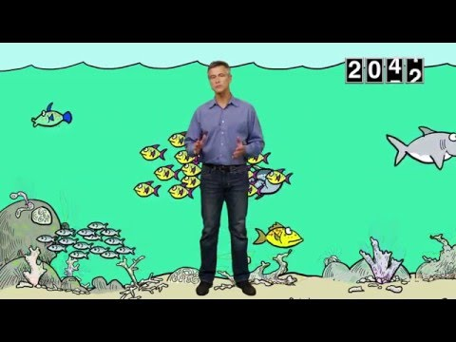
OCEAN
ACIDIFICATION
Notes:
The video talks about CO2 in the air… how bad is it and where does it come from?

Slide 21
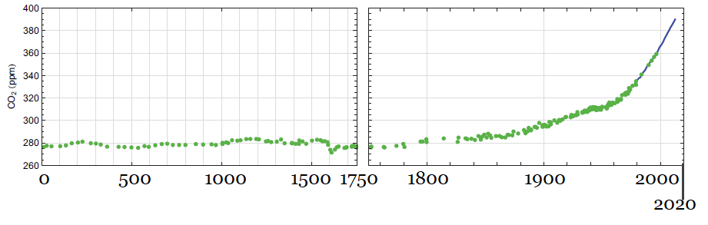
CO2 in the atmosphere

Slide 22
Greenhouse Gases
Examples?
Where do they come from?
Notes:
Carbon Dioxide - Burning Fossil Fuels, solid waste, deforestation. Forest regrowth takes it out of the atmosphere.
Methane (~12 years average lifetime in atmosphere) - production and transport of natural gas and coal. Also livestock and anaerobic decay in landfills
Nitrous Oxide (121 years average lifetime in atmosphere) - emitted during agricultural and industrial processes, fossil fuels and solid waste
Fluorinated Gases (can last a few weeks or thousands of years in atmosphere) - gases that contain flourine. Does not occur naturally. Happens in industrial and commercial processes, sometimes instead of ozone-depleting gases.

Slide 23

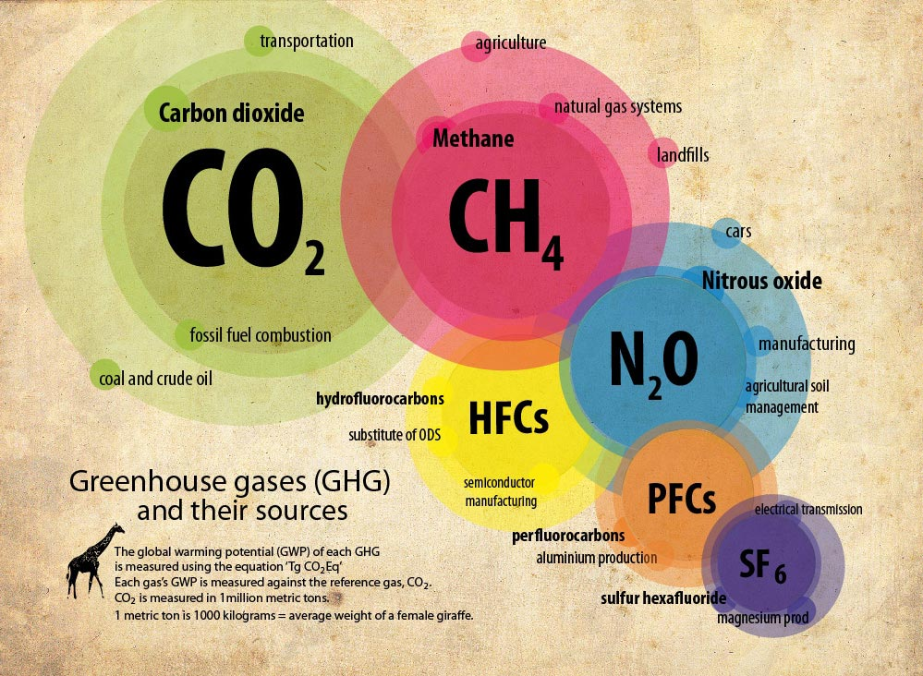
Notes:
Some more recent US sources have transportation contributing up to 28% - these might be because there is more transportation of goods in the US?
Carbon Dioxide - Burning Fossil Fuels, solid waste, deforestation. Forest regrowth takes it out of the atmosphere.
Methane (~12 years average lifetime in atmosphere) - production and transport of natural gas and coal. Also livestock and anaerobic decay in landfills
Nitrous Oxide (121 years average lifetime in atmosphere) - emitted during agricultural and industrial processes, fossil fuels and solid waste
Fluorinated Gases (can last a few weeks or thousands of years in atmosphere) - gases that contain flourine. Does not occur naturally. Happens in industrial and commercial processes, sometimes instead of ozone-depleting gases.

Slide 24
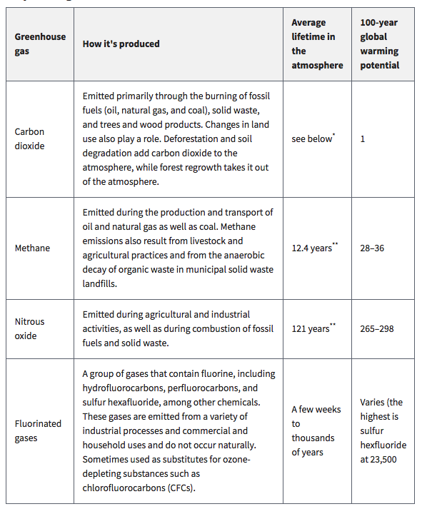
Notes:
Slide for reference, won’t show up in presentation

Slide 25
CO2 dissolution
steps 1-4
CO2 in oceans

Slide 26
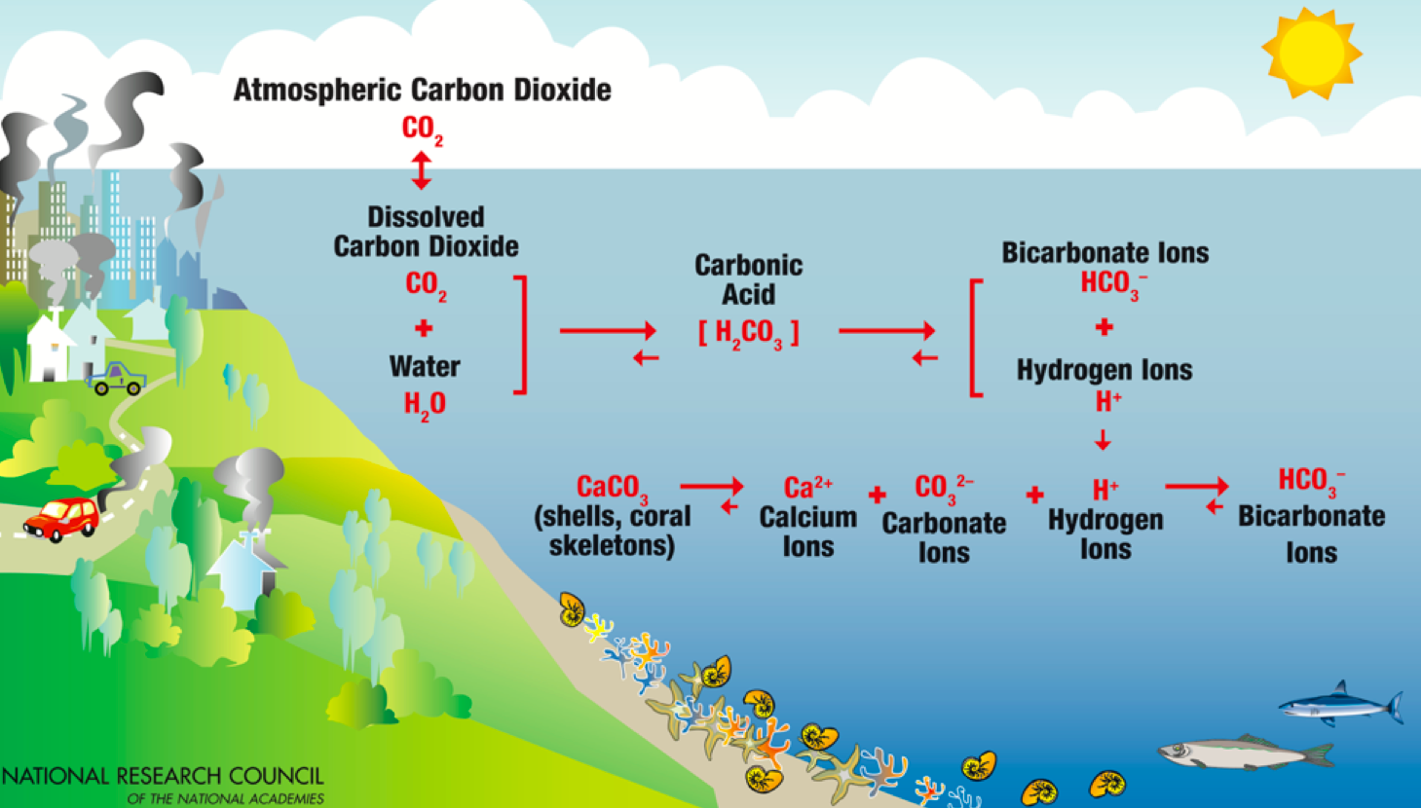
Carbon Cycle
Notes:
Carbon cycle notes:
Start in top left - carbon dioxide reacts with water to form carbonic acid. Carbonic acid dissociates to form bicarbonate ions and hydrogen ions. Note: acidity is the amount of hydrogen ions (H+)! In fact, the equation for pH is: pH=-log[H⁺]!
Hydrogen ions push the equilibrium of the bottom line in the picture from CaCO3 towards bicarbonate ions. That is, the acid (H+) is ‘trapping’ the CO3 in a non-shell form, “pulling” CO3 away from shells.

Slide 27
grab cups &
predict pH in each cup
DON’T TOUCH THE SHELLS YET!

Slide 28
Shell experiment
steps 1-5
effects of ocean acidification

Slide 29
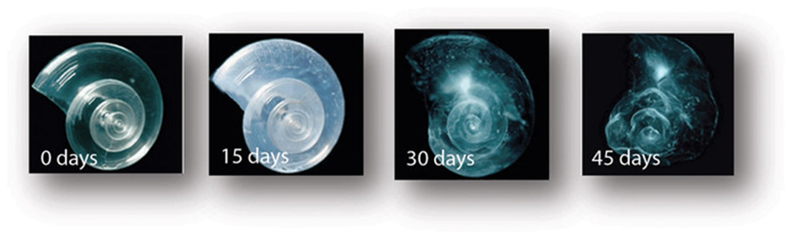

Slide 30
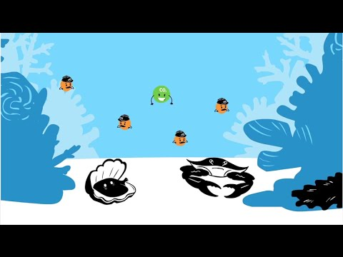
OCEAN
ACIDIFICATION
AND SHELLS
Notes:
The video talks about CO2 in the air… how bad is it and where does it come from?

Slide 31
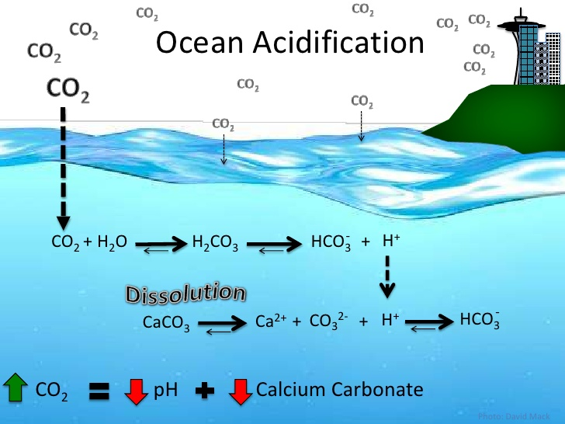

Slide 32
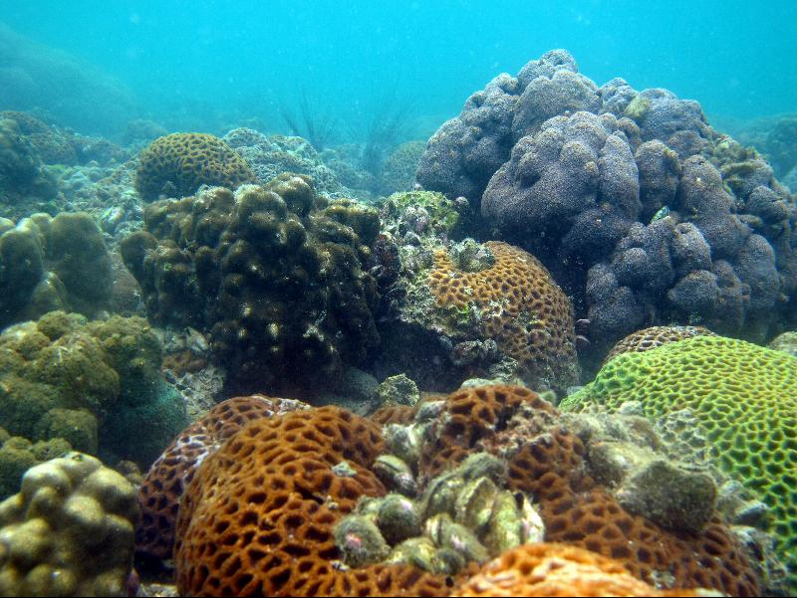
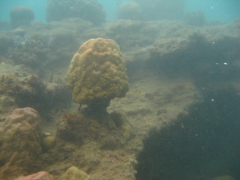
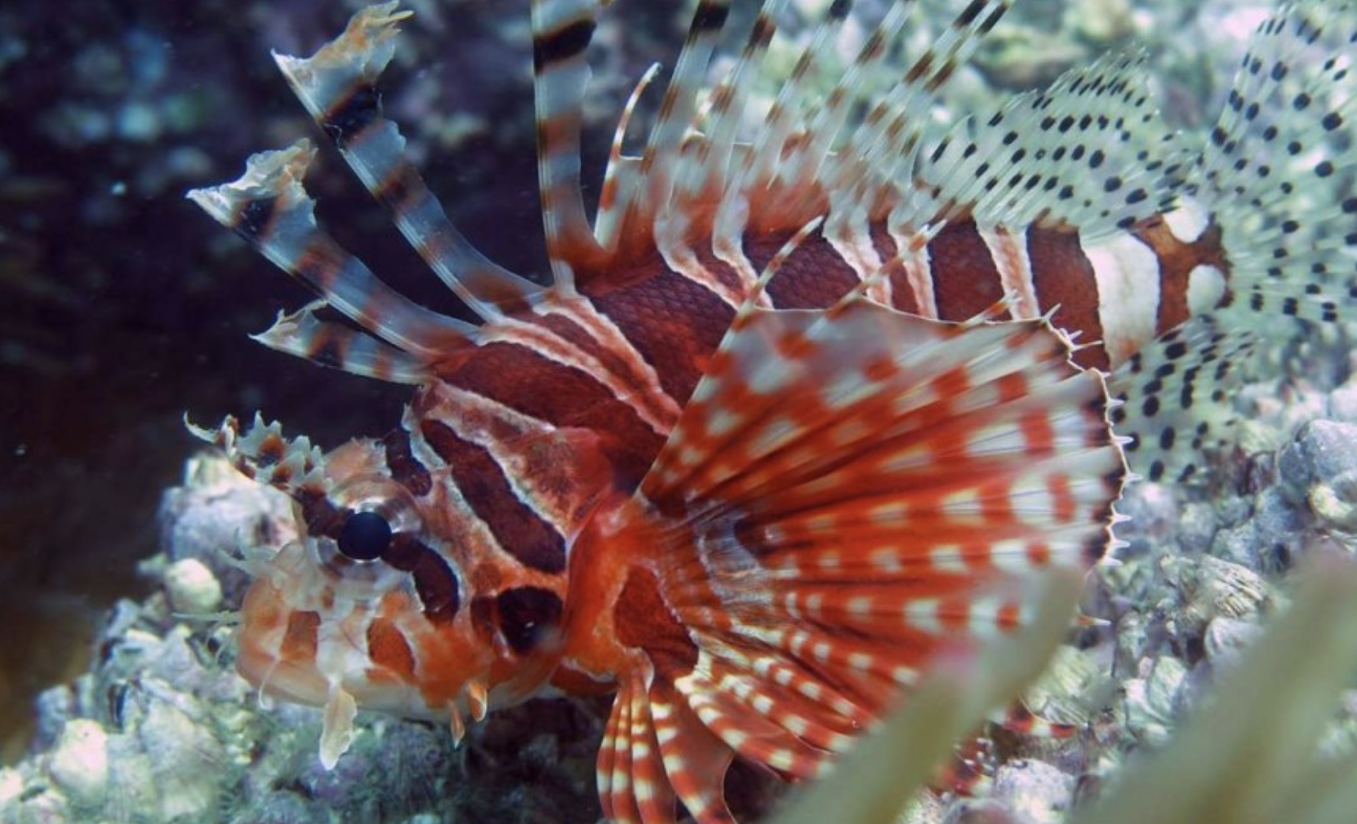
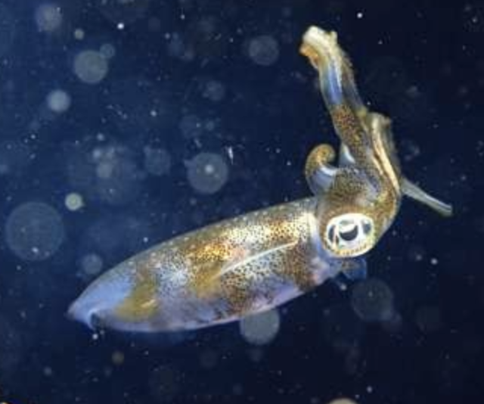
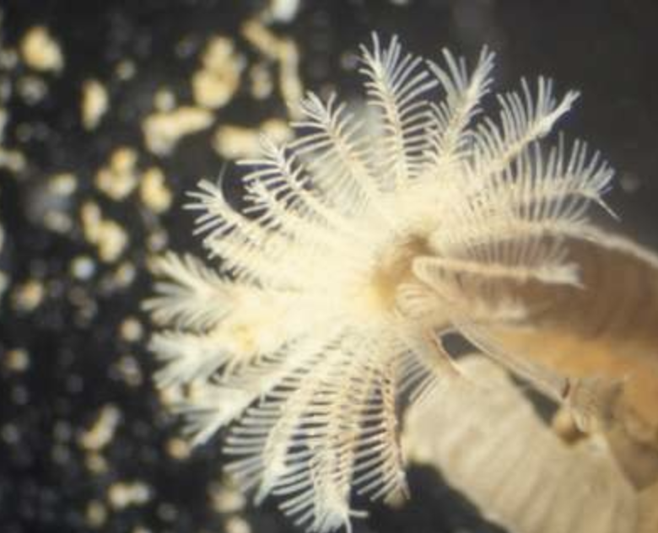
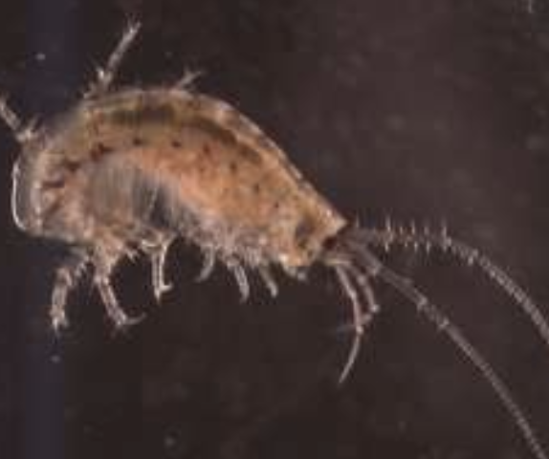
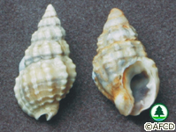
Ocean Acidification and Hong Kong
Notes:
HK has incredible biodiversity. The Baltic Sea is 200 times larger, but HK has same level of biodiversity. 5,943 species. Also 84 hard coral species, which is more than in the Caribbean. https://www.scmp.com/news/hong-kong/health-environment/article/2058023/under-sea-species-flourish-hong-kong-waters-study
However, global warming and ocean acidification can have a toll.
Coral can start to lose its structure in acidic environments (unhealthy picture from Papau New Guinea): https://www.hku.hk/press/press-releases/detail/15558.html
Shells: Nassarius festivus which are in Hong Kong. 2016 thesis from University of HK says that its larva growth are affected by ocean acidification http://lbms03.cityu.edu.hk/theses/c_ftt/phd-bch-15459939.pdf

Slide 33
Antacid Water experiment
steps 1-4
acid/base reactions

Slide 34
What are remedies to acidification?
Notes:
Although adding bases seems like a good solution, this is not feasible because the ocean is so huge (need 25 times annual production of limestone to fix the ocean)
The shells also help, but then we are losing those creatures, harming biodiversity
Ultimately, the best solution is to reduce CO2 emission to slow down ocean acidification

Slide 35
